Slide 1

Hardware Accelerator for SHA-1 and proof-of-work
Gianluca Radi
Saverio Nasturzio
Real-Time Embedded Systems

Slide 2
Project in a nutshell
Emulation of a block chain employing a simplified version of the proof-of-work technique, with a fixed number of miners hashing input blocks according to the SHA-1 algorithm.
Hardware and software (with and without custom instructions) implementations of the miners.
Performance profiling of the different implementations.

Slide 3
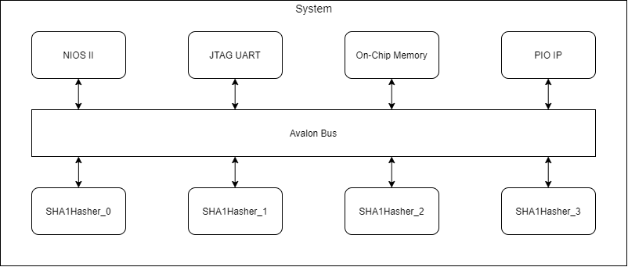
Overview of the system

Slide 4
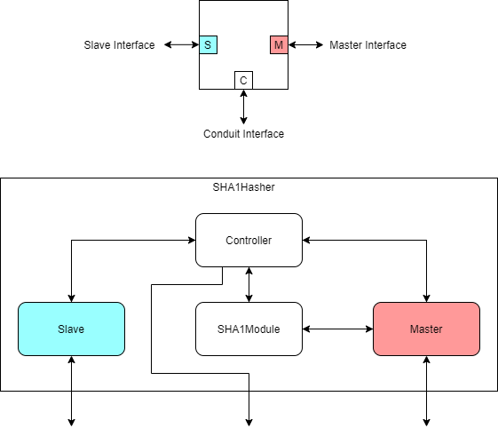
SHA-1 Hasher
Hardware accelerator computing hashes compliant with the specified complexity (number of 0’s in msb) for each input block.
Exposes Avalon Slave, Master and Conduit interfaces.
Composed of 4 sub-modules: Slave, Master, SHA1Module and Controller.

Slide 5
Slave
Exposes register map to allow the application to write and read on its registers.
The user can specify initial read address, initial write address, number of input blocks, complexity, and nonce increment policy.

Slide 6
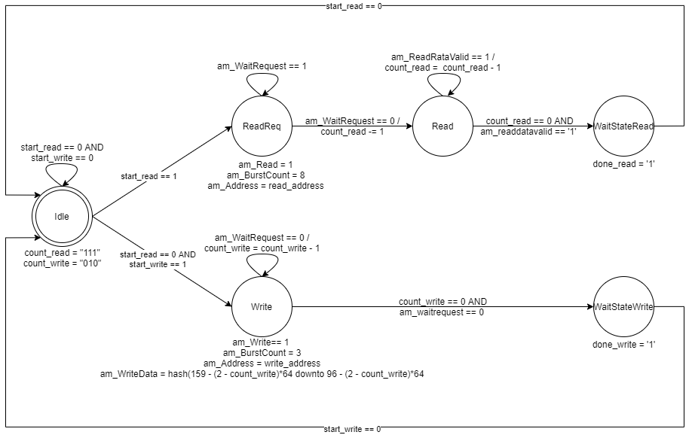
Master
Reads input blocks, one by one, from memory using a read burst transfer.
Writes backs resulting hashe and the nonces used to compute them, one by one.

Slide 7
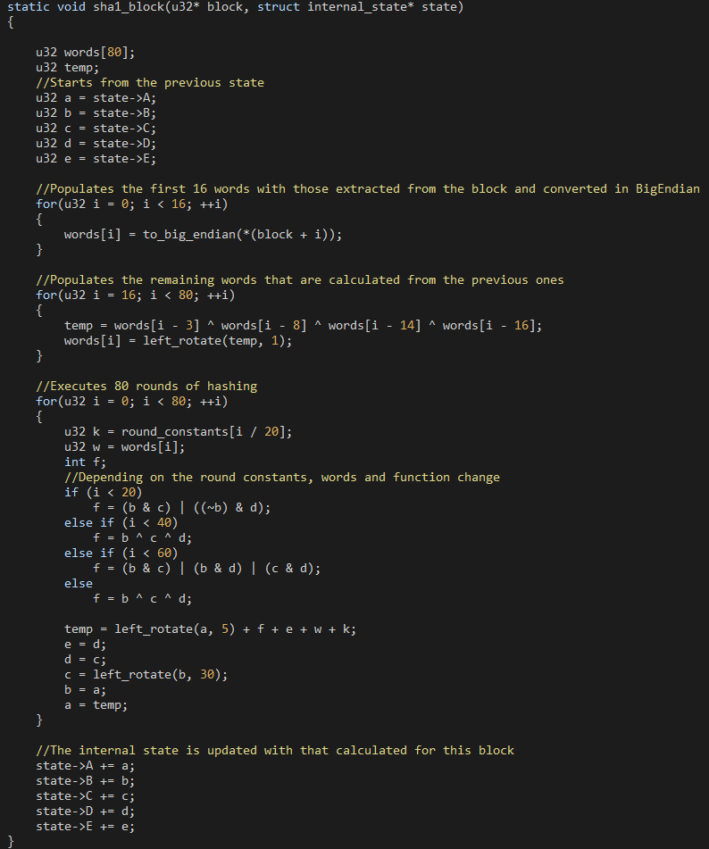
SHA-1 Module
Computes the hash for a single input block according to the SHA-1 algorithm.
SHA-1 algorithm presents two main phases:
Population of an array of 80 32-bit words.
80 iterations in which the internal state (5 32-bit words) is updated according to pre-defined constants and functions that depend on the iteration number.
Great emphasis was put on modularity so to ease the optimizion of the algorithm.

Slide 8
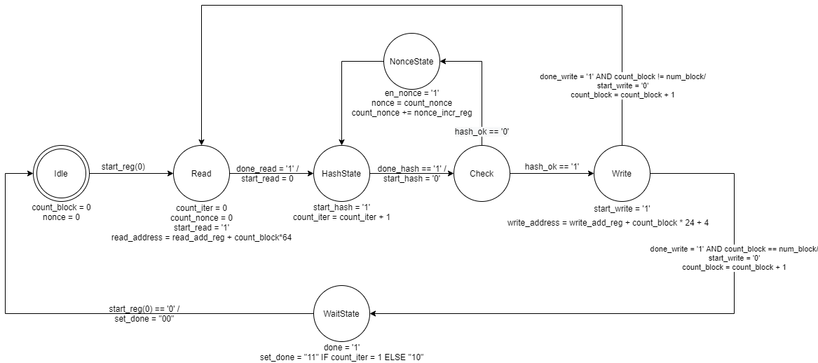
Controller
Orchestrates the functioning of the other sub-modules.
Triggers the Master for both read and write transactions.
Triggers the SHA-1 Module.
Asserts the compliance of the computed hash with the specified complexity.
If the hash is incorrect, the 32 lsb are updated according to the specified nonce increment policy.

Slide 9
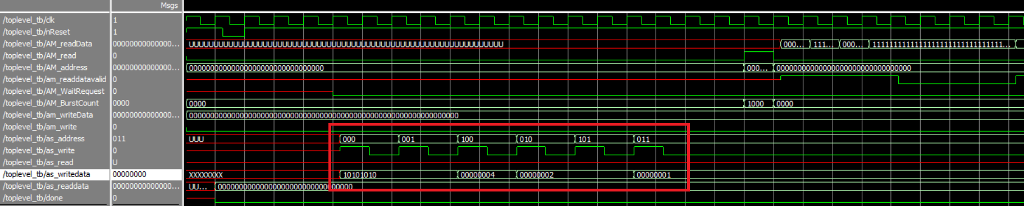
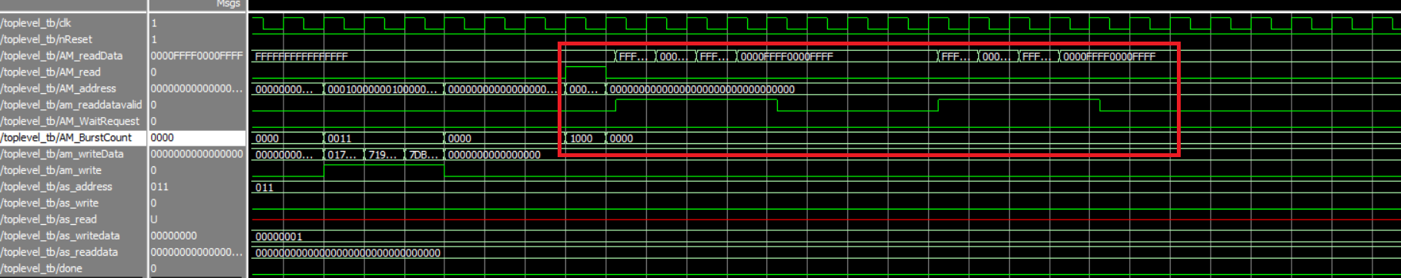
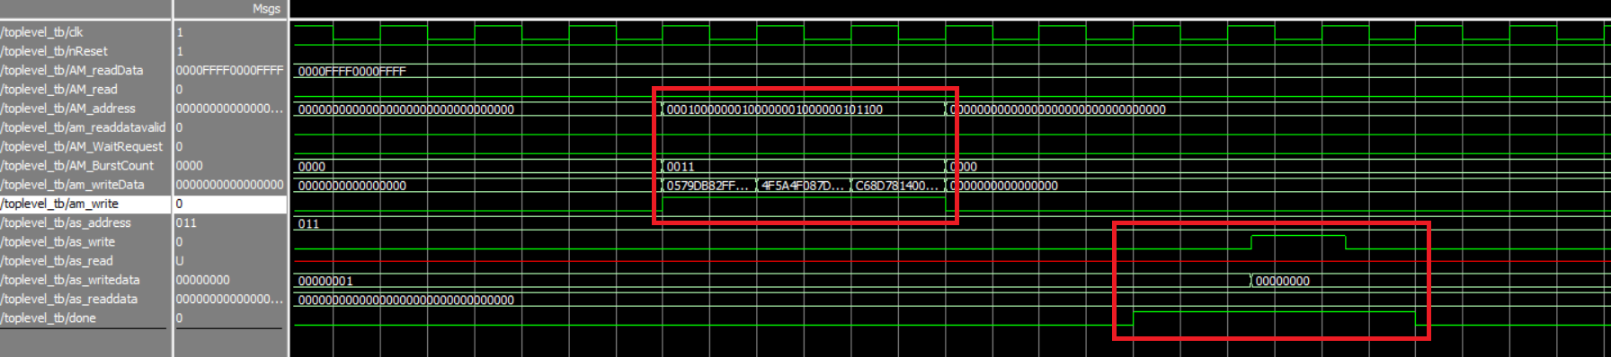
Testbenches

Slide 10
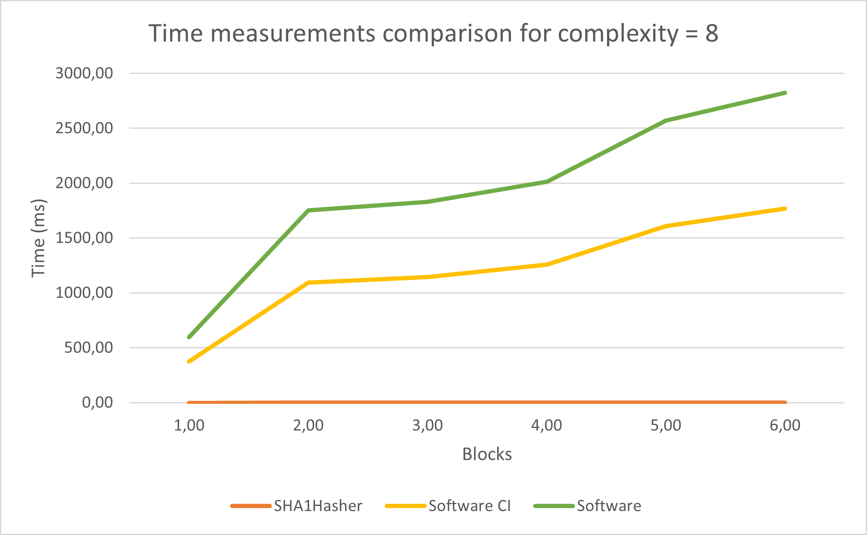
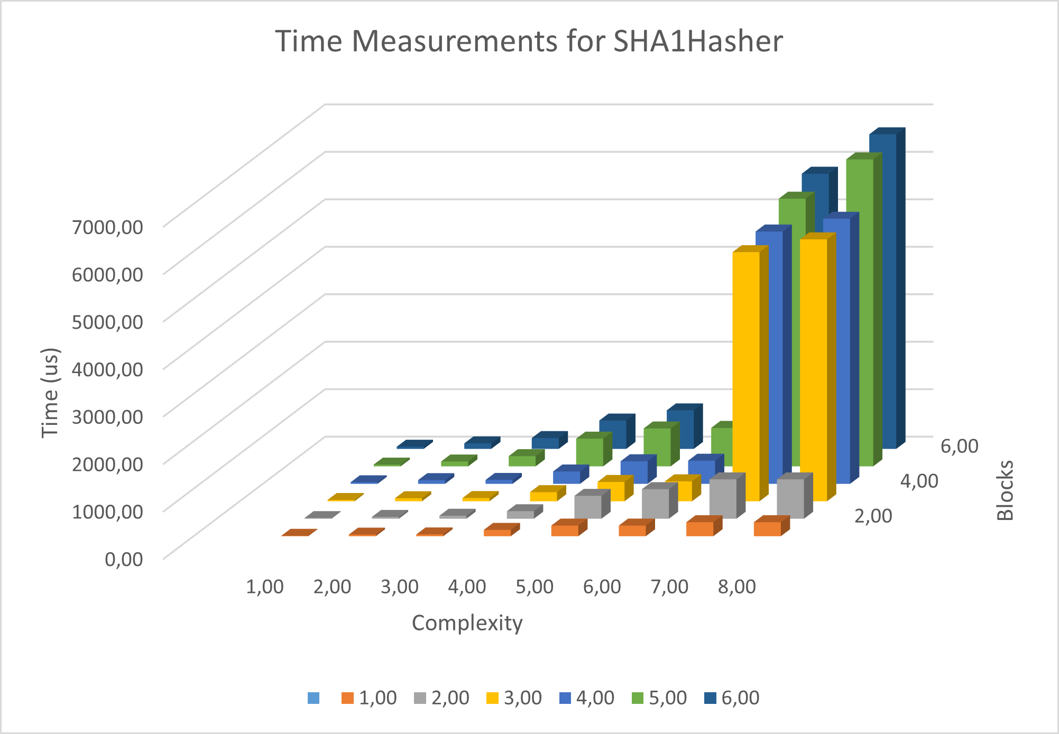
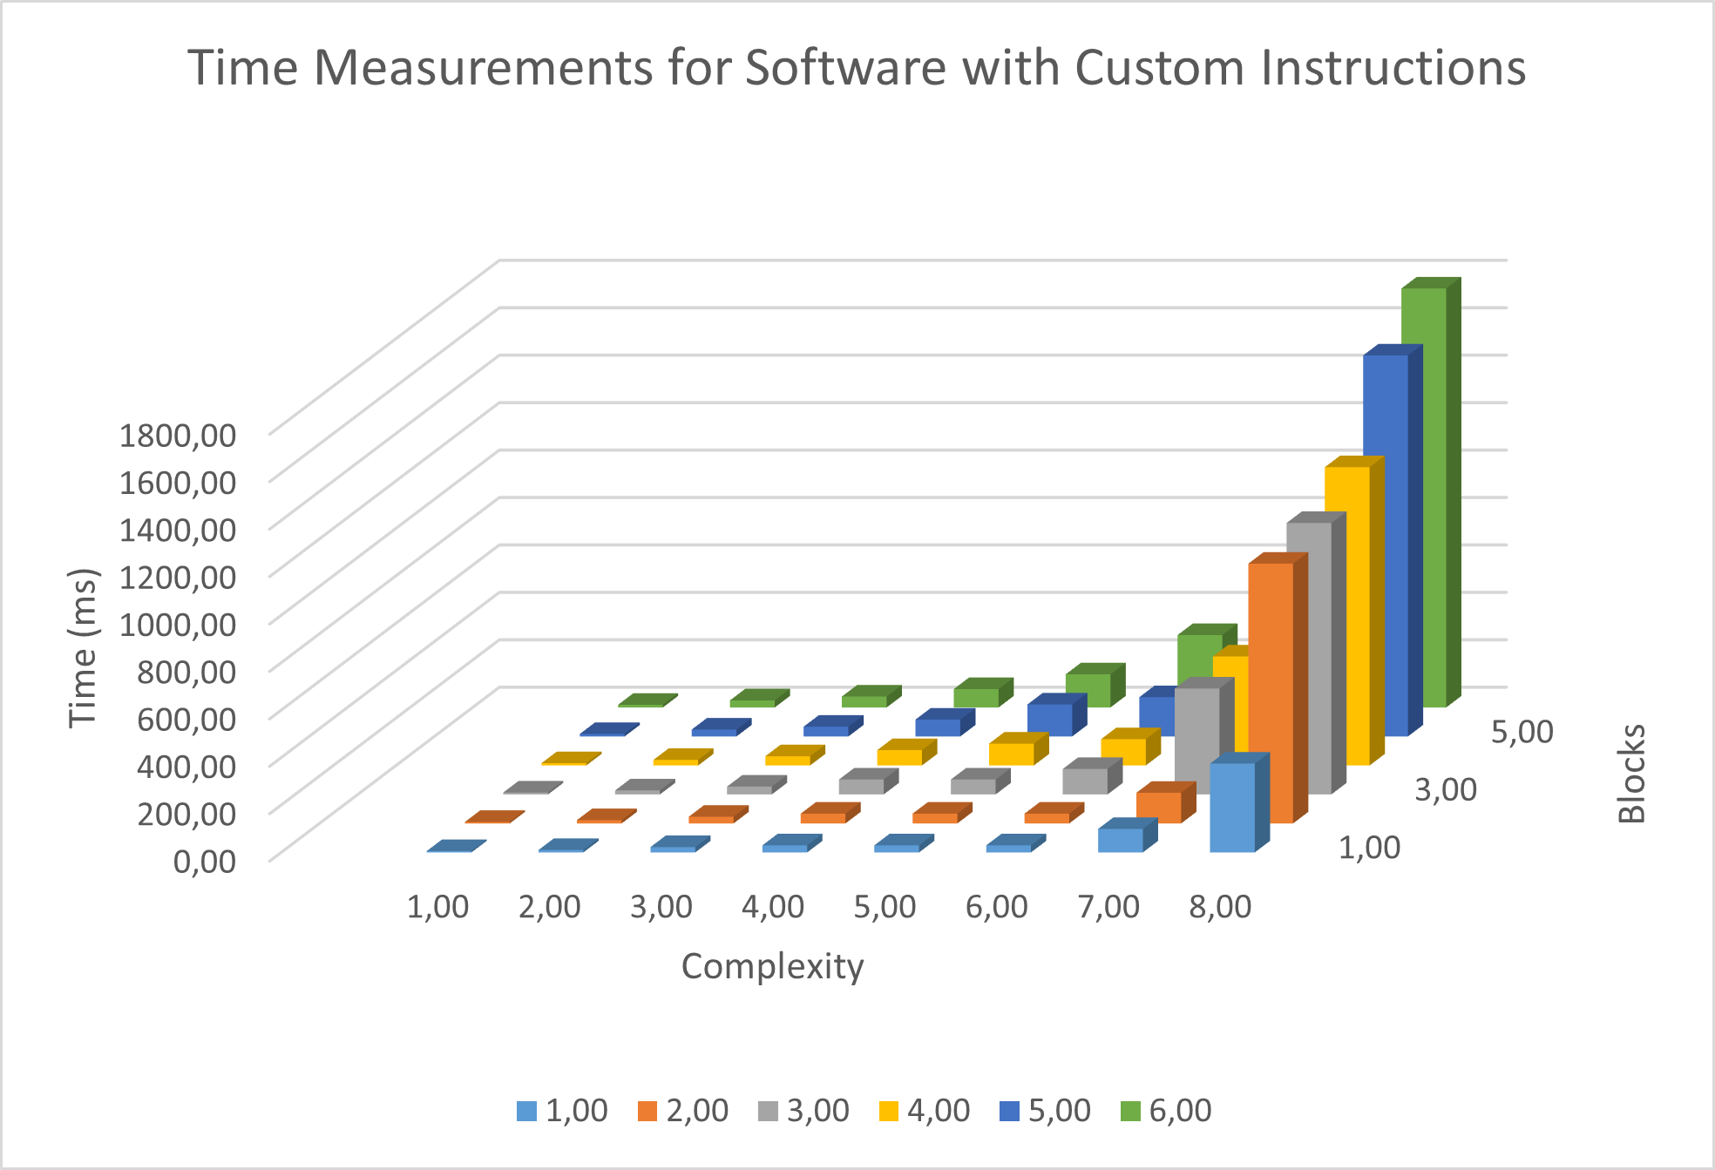
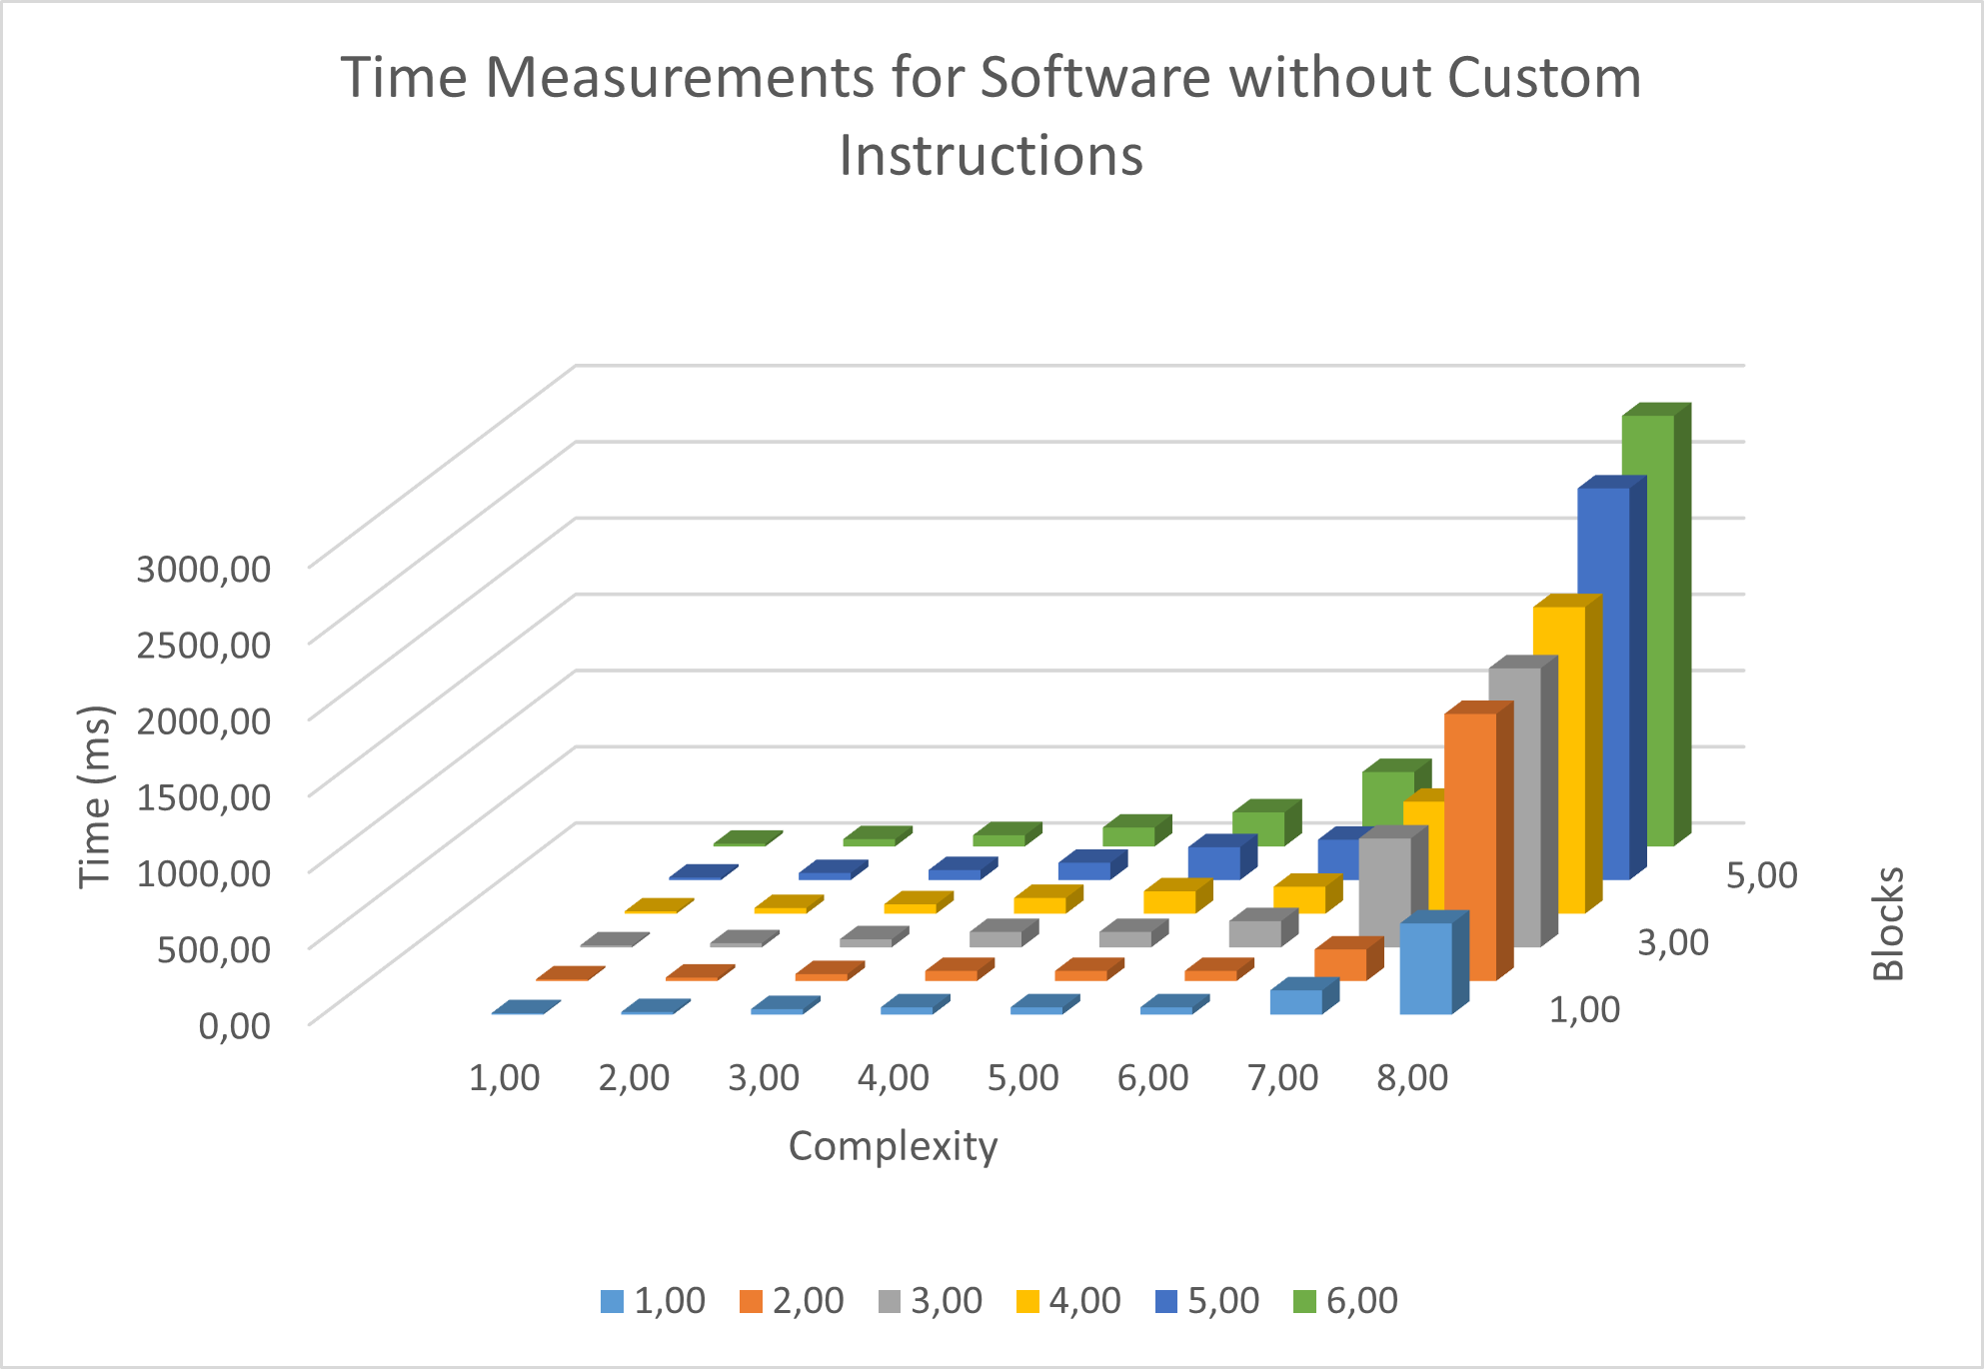
Performance Analysis

Slide 11
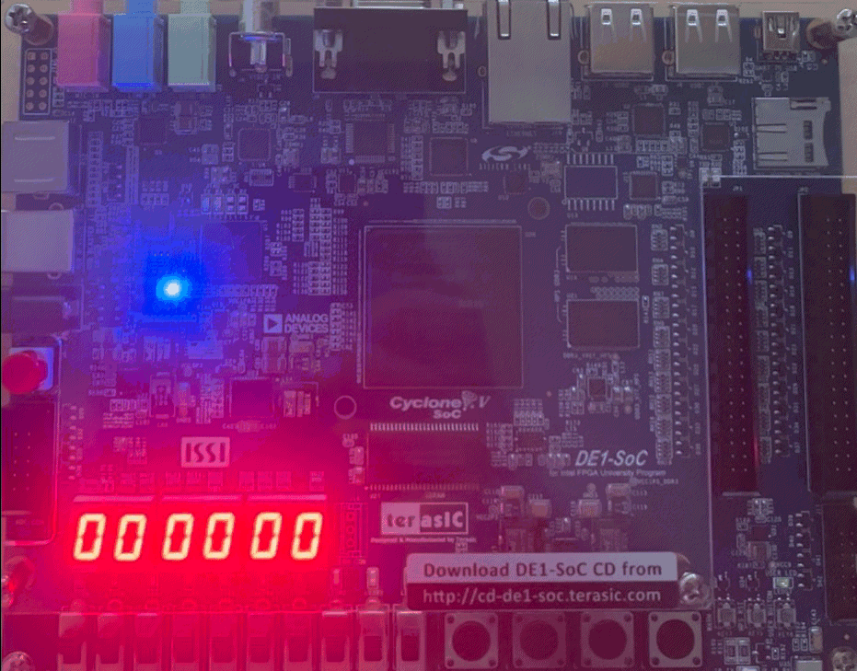
Demo time…

